Slide 1
Vertikale referentie en getijreductie buiten Nederland
Martin.verlaan@deltares.nl

Slide 2
Outline
Introduction
A global tide and surge model
LAT computations
Tidal corrections
MDT

Slide 3
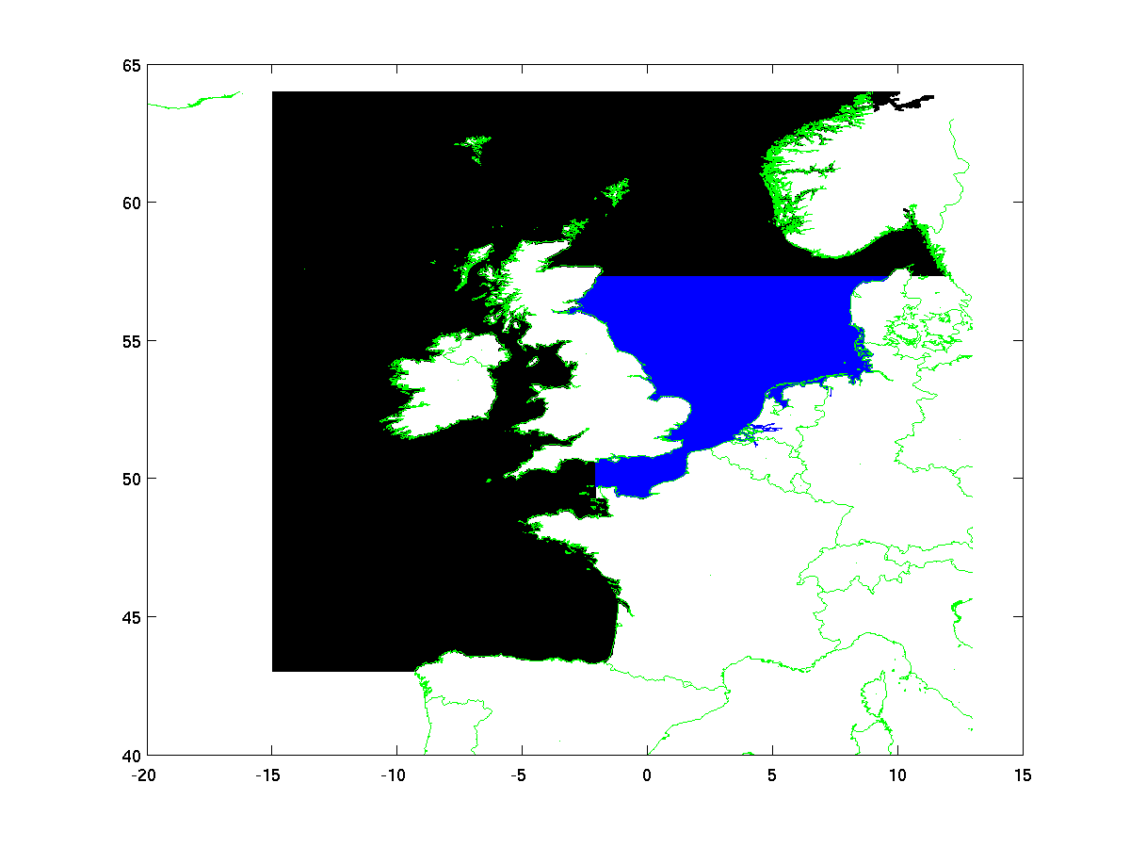
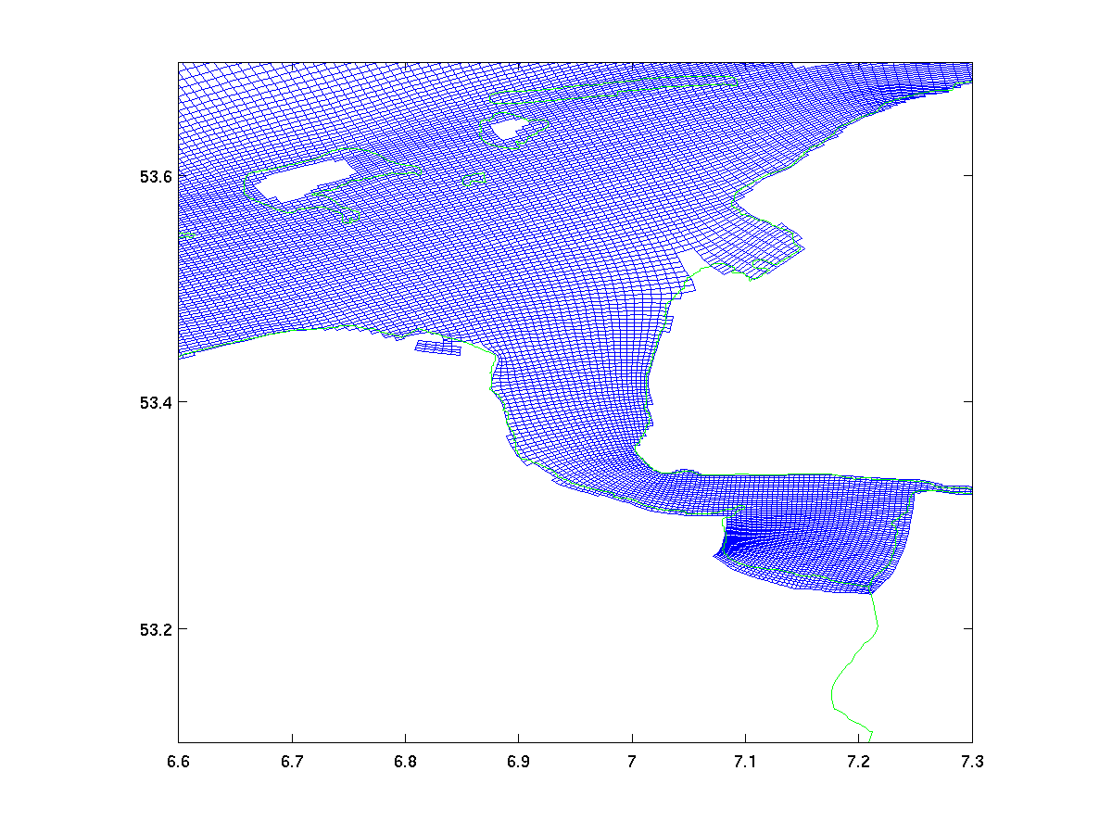
From regional to global
Operational storm-surge model in Netherlands DCSM-ZUNO

Slide 4
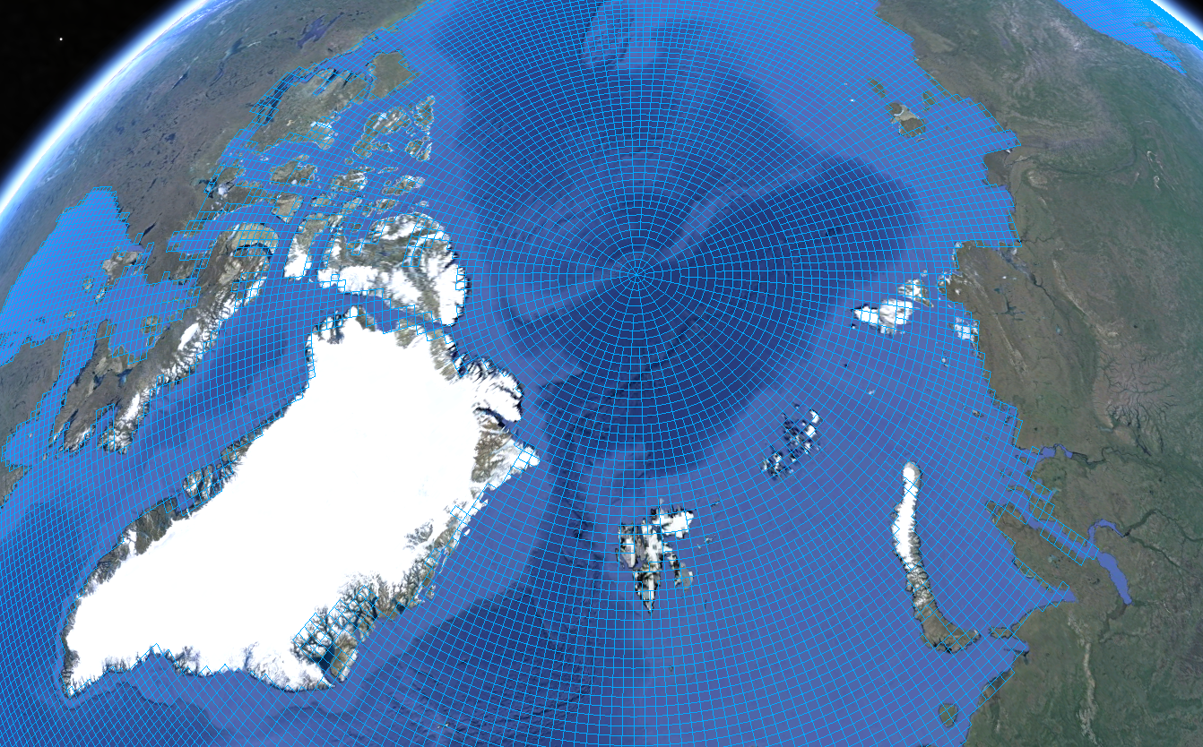
Grid in DELFT3D-FM
Unstructured approach - step 1: grid thinning at high latitudes

Slide 5
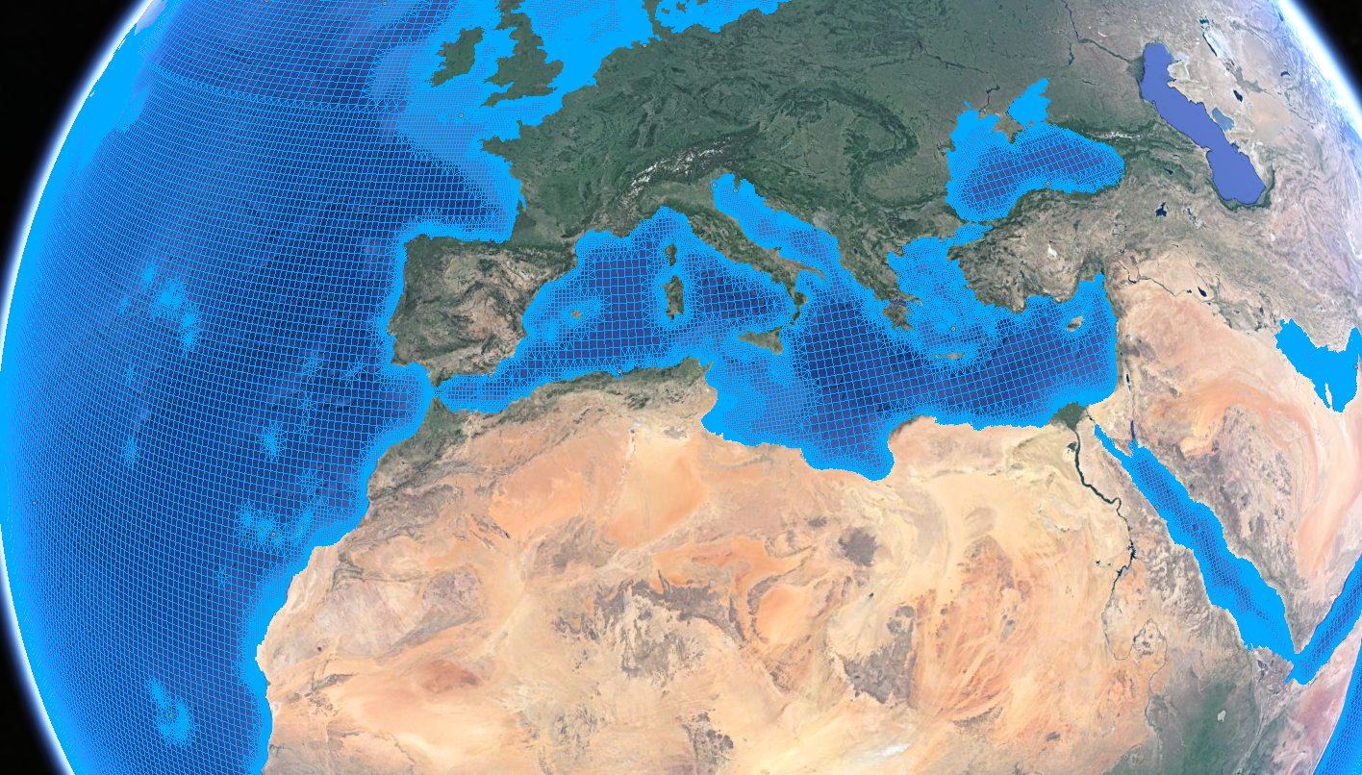
Grid in DELFT3D-FM
Unstructured approach - step 2: grid refinement in shallow areas
This DELFT3D-FM grid uses triangles and rectangles
for local grid refinement. Resolution is based on Courant number.

Slide 7
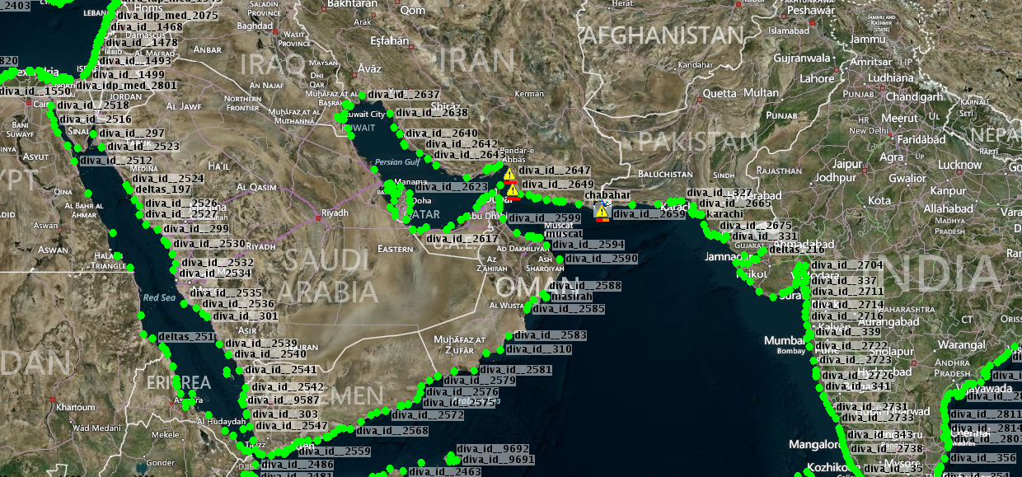
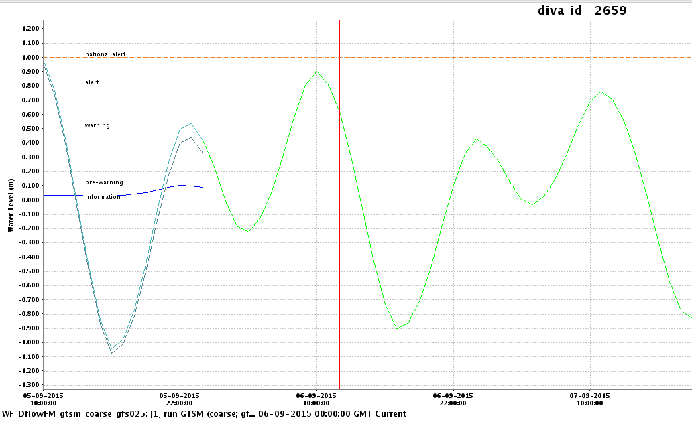
Operational forecasts 4x per day
GLOSSIS uses FEWS environment

Slide 8
A global LAT

Slide 9
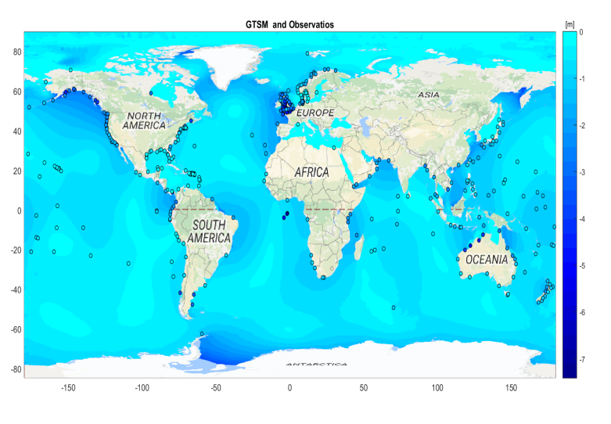
LAT worldwide
LAT version 2016

Slide 10
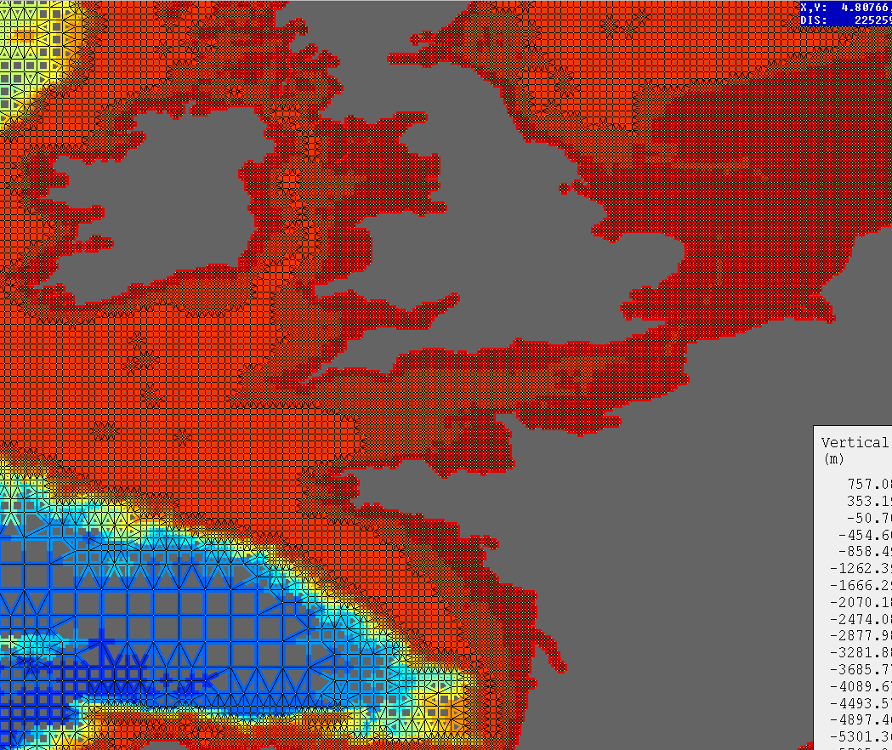
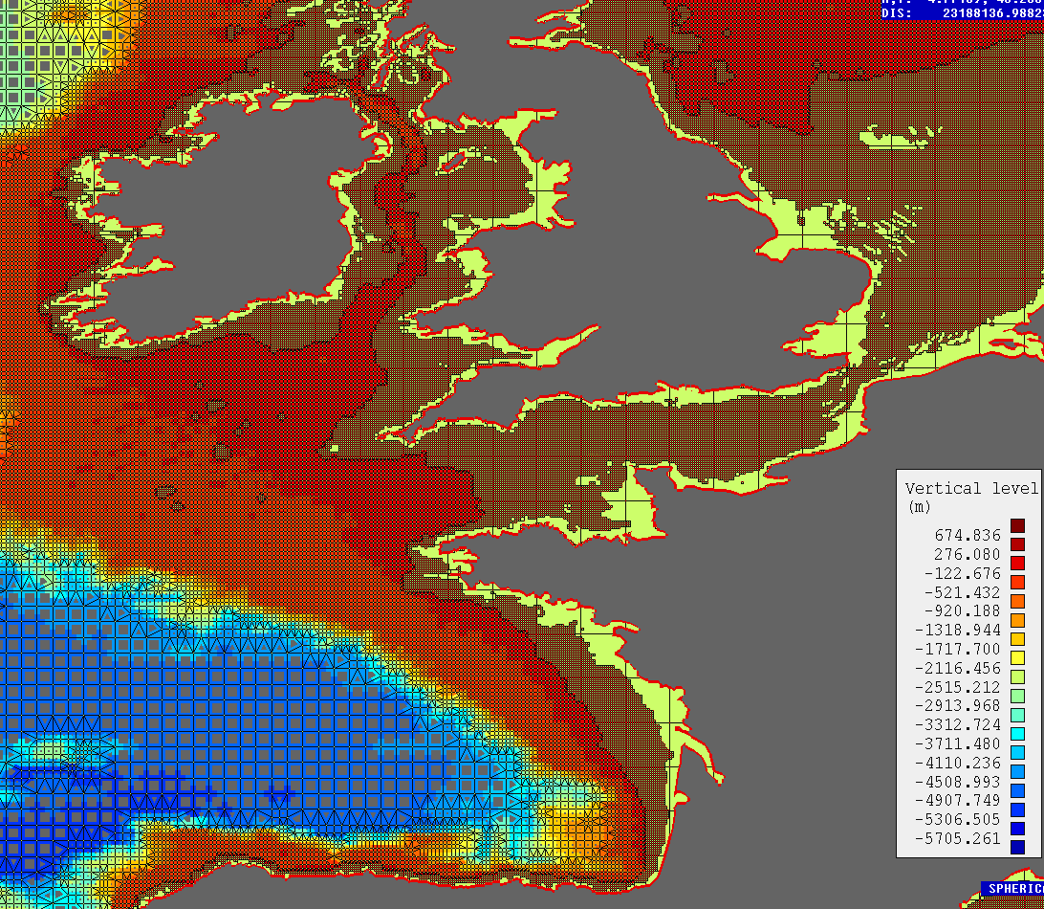
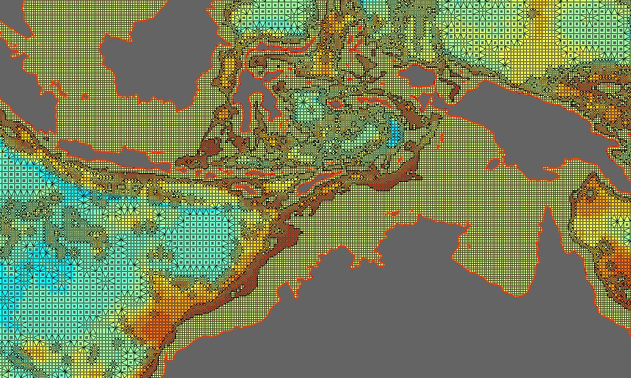
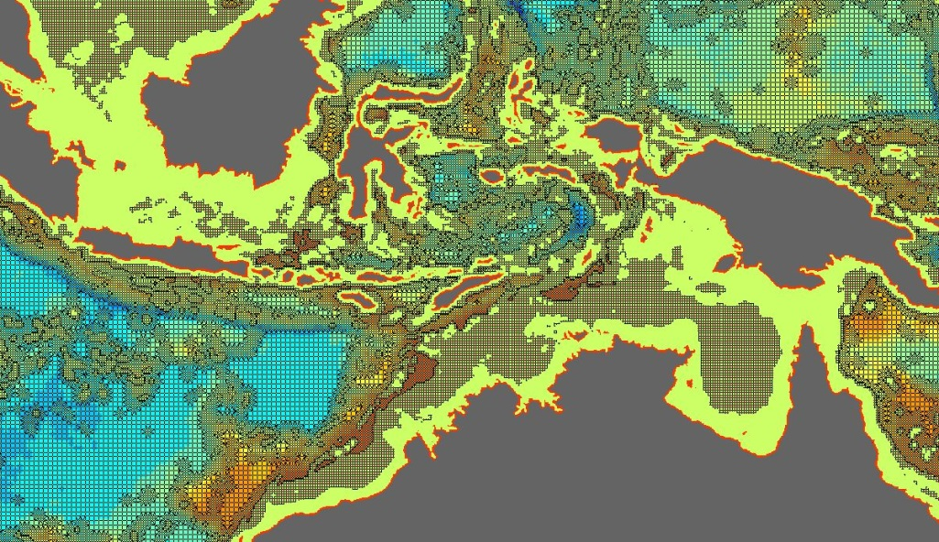
Increased grid resolution
Deep water 50km →25km
Coast: 5km→2.5km globally, 1.25km Europe
Smoothing at 2.5km resolution
Larger coverage of refinement at steep bathymetry (5km)

Slide 11
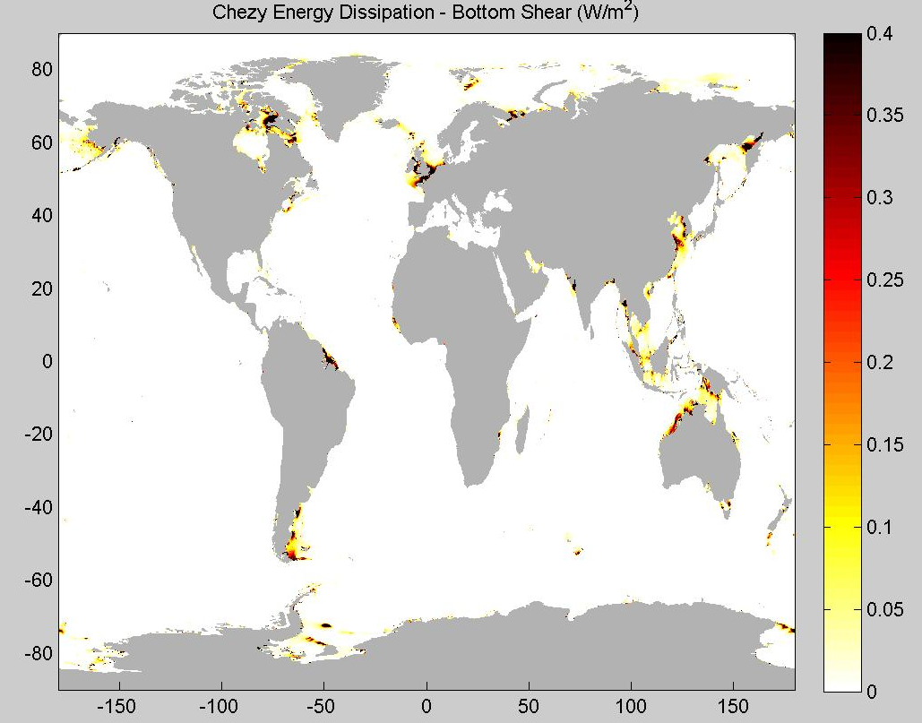
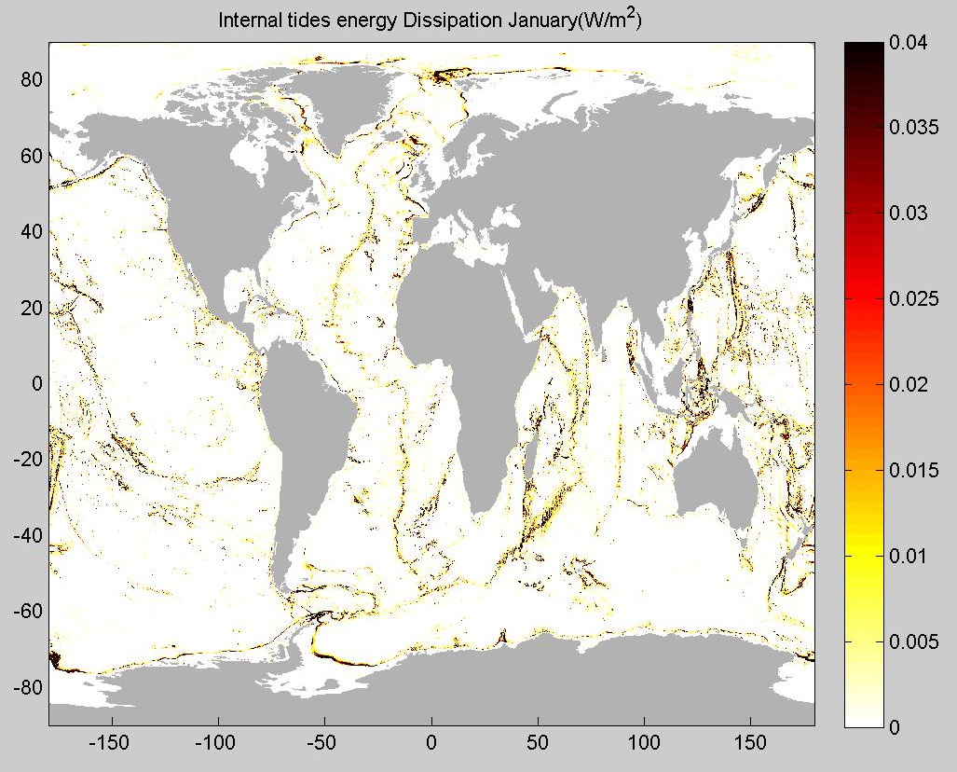
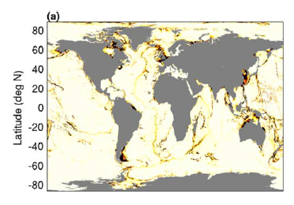
IT dissipation- Results
BF dissipation (TW)– Literature ~2,5TW | IT dissipation (TW)– Literature ~1TW
2,47 | 1,17
Std ocean 10,3cm to 6,3cm
Std coastal observations 22,6cm to 16,4cm
Spatial pattern matches literature
Quantitative assessment made in resolution study (coming slides)

Slide 12
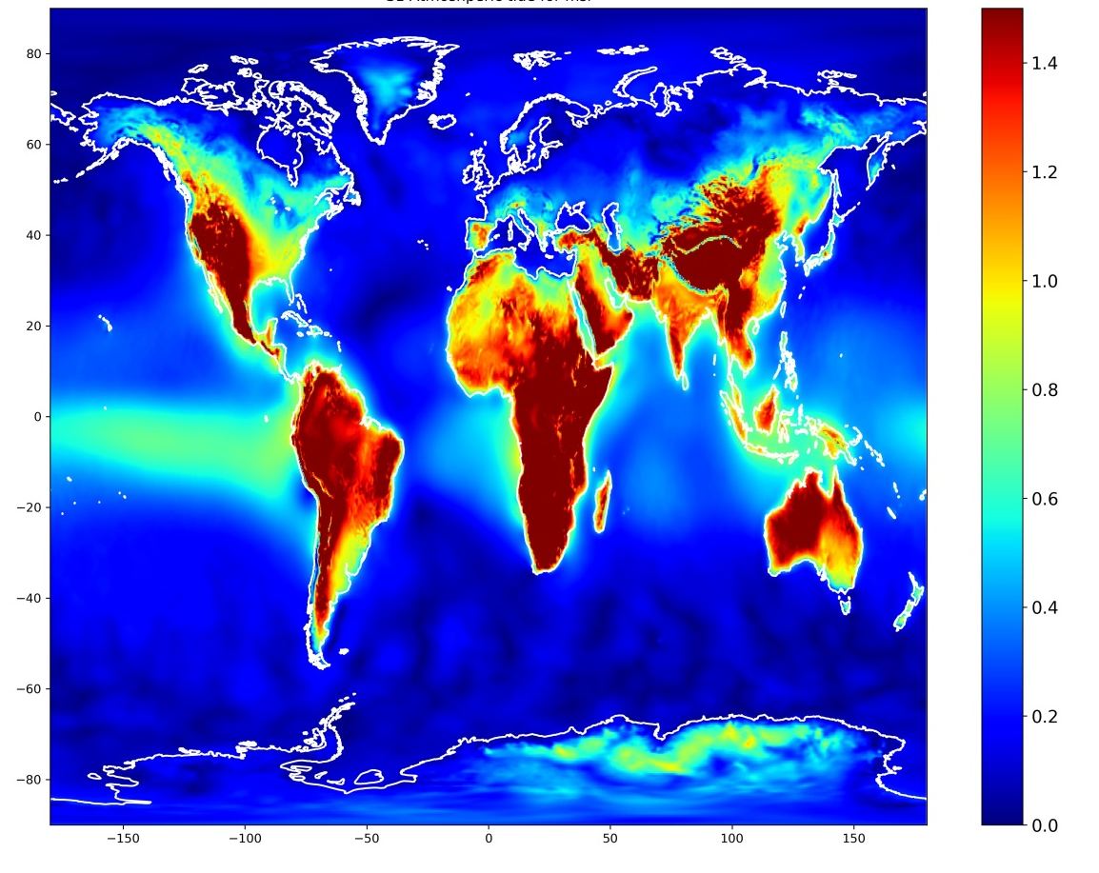
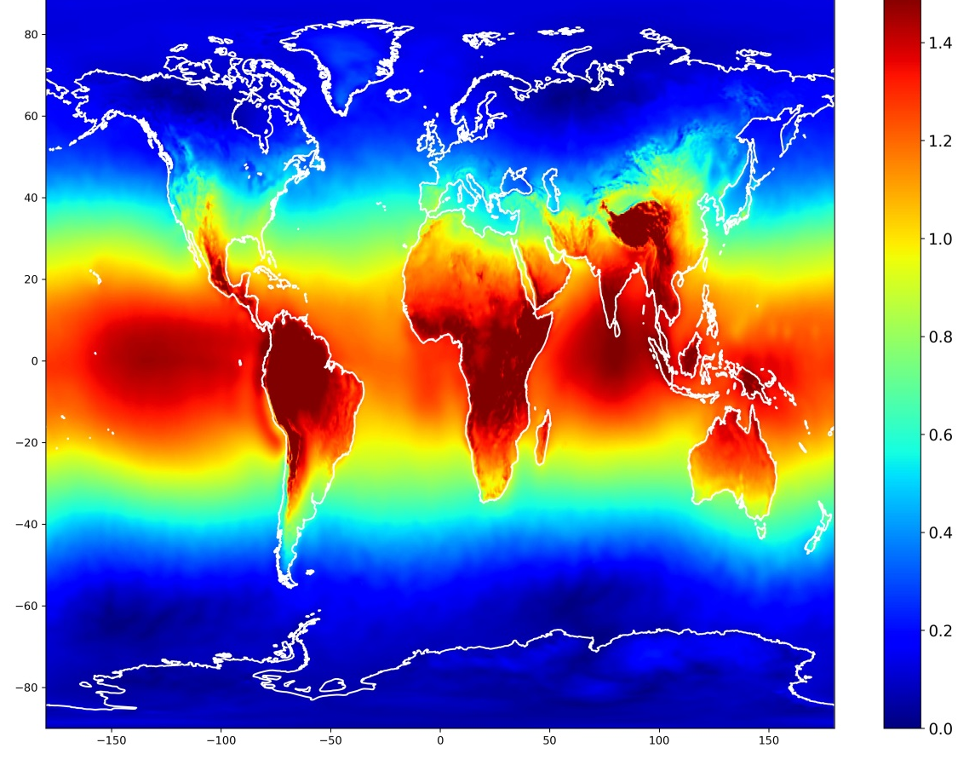
Radiational tides
S1 atmospheric tide
S2 atmospheric tide
Oceanic response to the atmospheric tides (“air tides”), resulting from solar radiation.
Mainly pressure loading, wind stress considered negligible
S1,S2,SS1,S1
➔Harmonic analysis of surface pressure and wind stress maps from 7 years of ERA5 (0.25deg, 1hour)

Slide 13
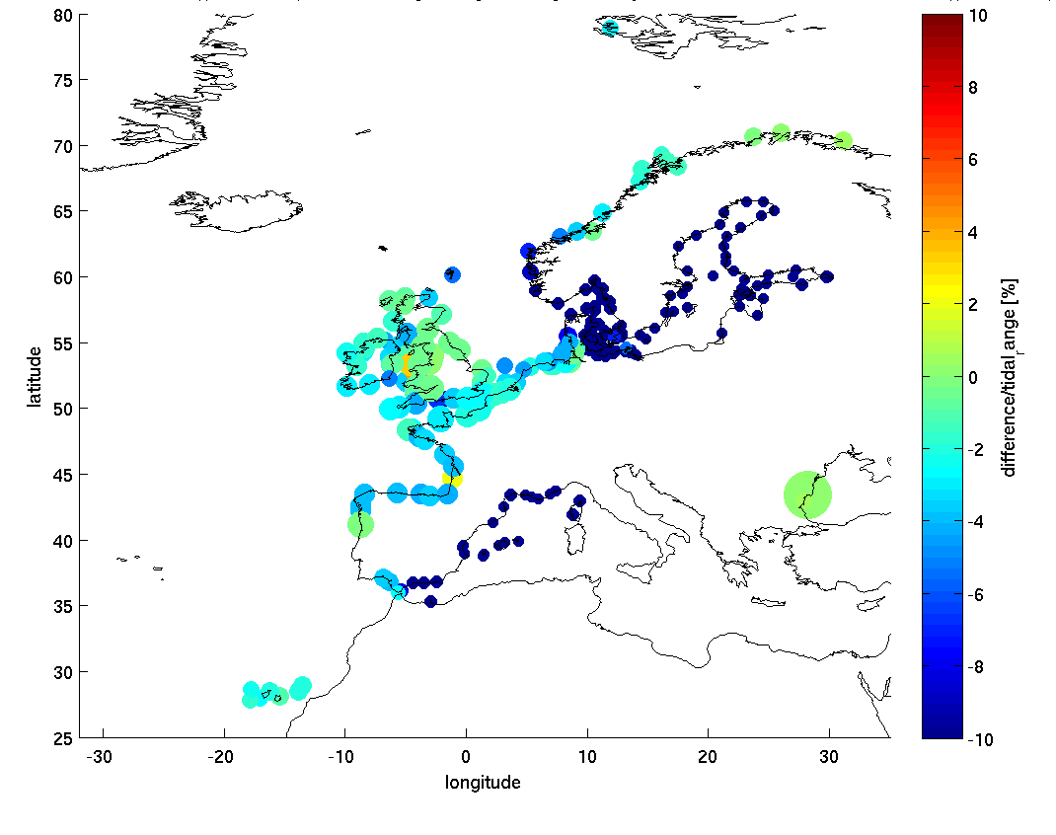
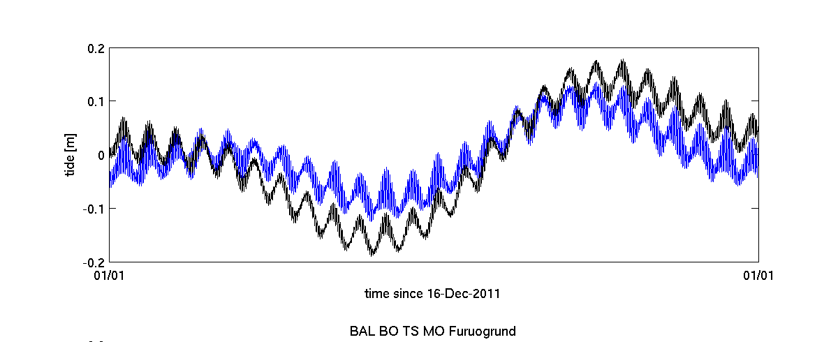
Radiational tides
Modelled tide [m] at Furuogrund (Baltic) without (upper) and with(bottom) radiational tides. Radiational seasonal signal is remarkable.
Tidal error change [%] relative to tidal range. Mediterranean and Baltic significantly improved

Slide 14
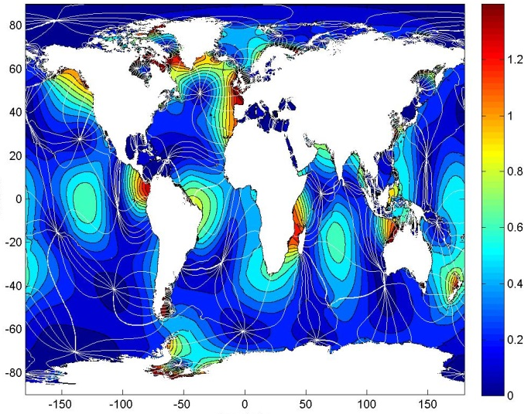
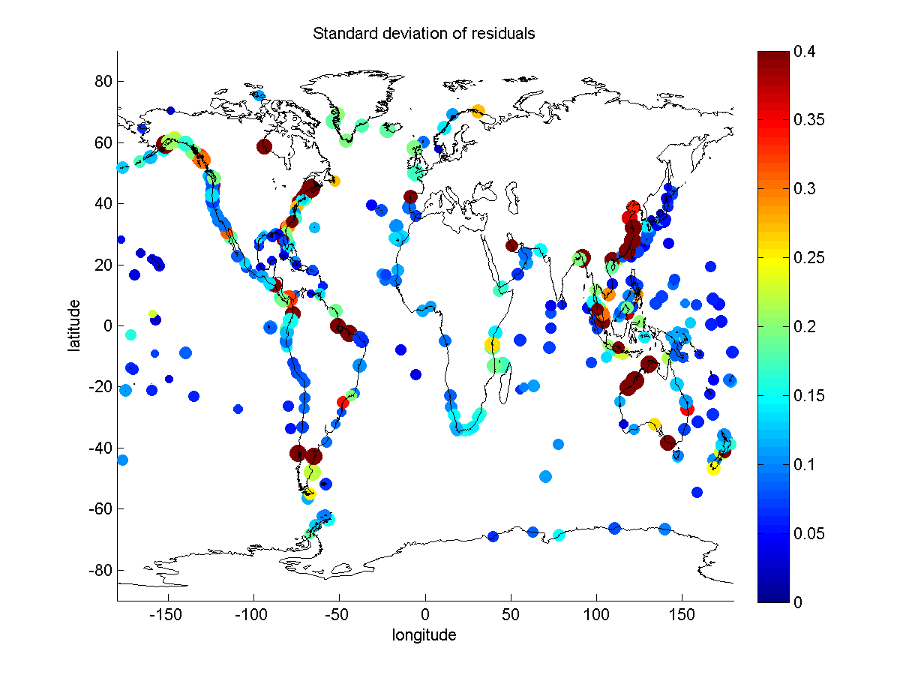
The GTSMv3.0 performance – tides
Comparison to state of the art tidal models from Stammer et al. (2014):
Model | Type | deep ocean M2 | Coast M2
GTSMv3.0 | Non-assimilative | 3,5cm | 10,5cm
FES2012 | Assimilative(satellite) | -- | 4,5cm
Av. assimilative | Assimilative(satellite) | -- | 10,41cm
Best. Non-assimilative | Non-Assimilative | 5,63cm | 21.1cm

Slide 15
Tide corrections

Slide 16
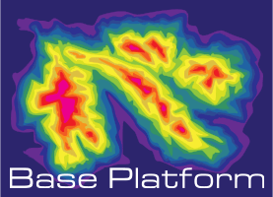
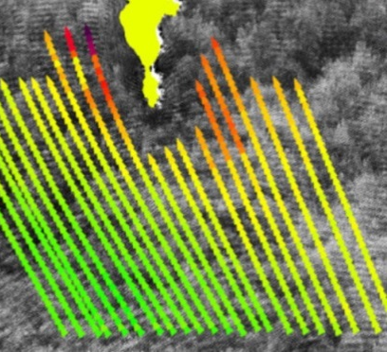
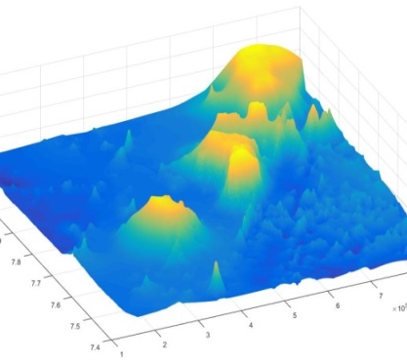
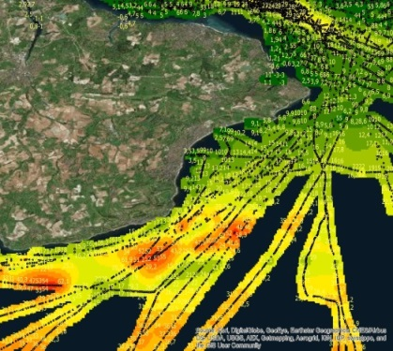
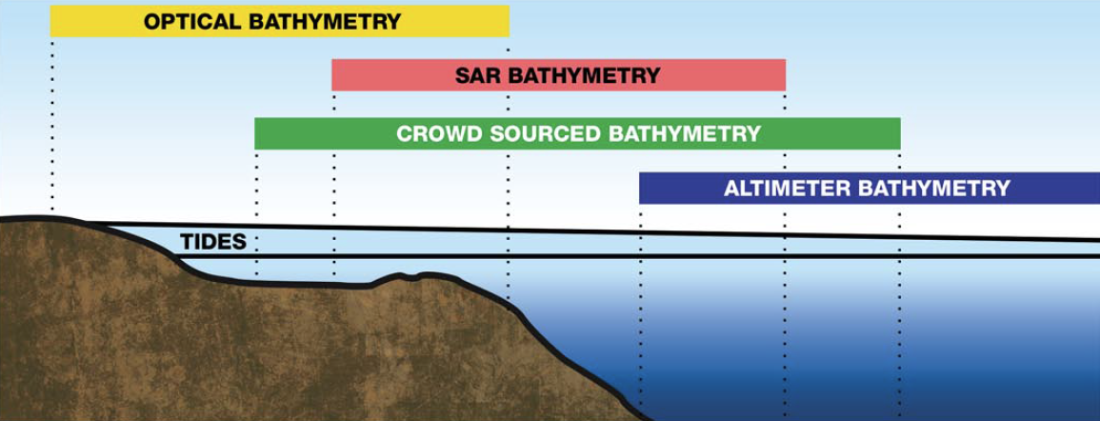
Bathymetry from space : www.BASE-platform.com
SAR
Altimeter
Optical
Waterlevel
Crowd sourced
Notes:
I would mention the complementary nature of the various data sources, eg different depth range.

Slide 17
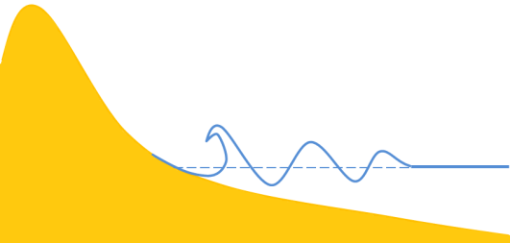
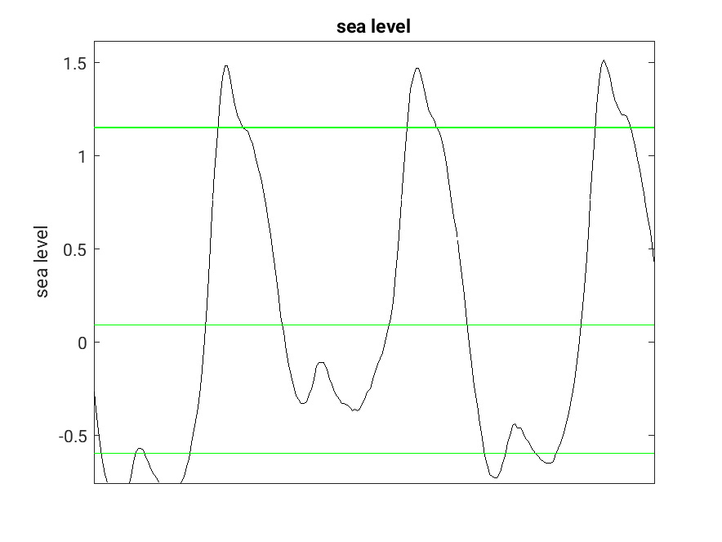
Coastline validation with satellite data
90% dry
Satellite water
detection
10% dry
90% sealevel
High water
High waterline
Low water
10% sealevel
Low waterline
Numerical
model
High-res
bathymetry

Slide 18
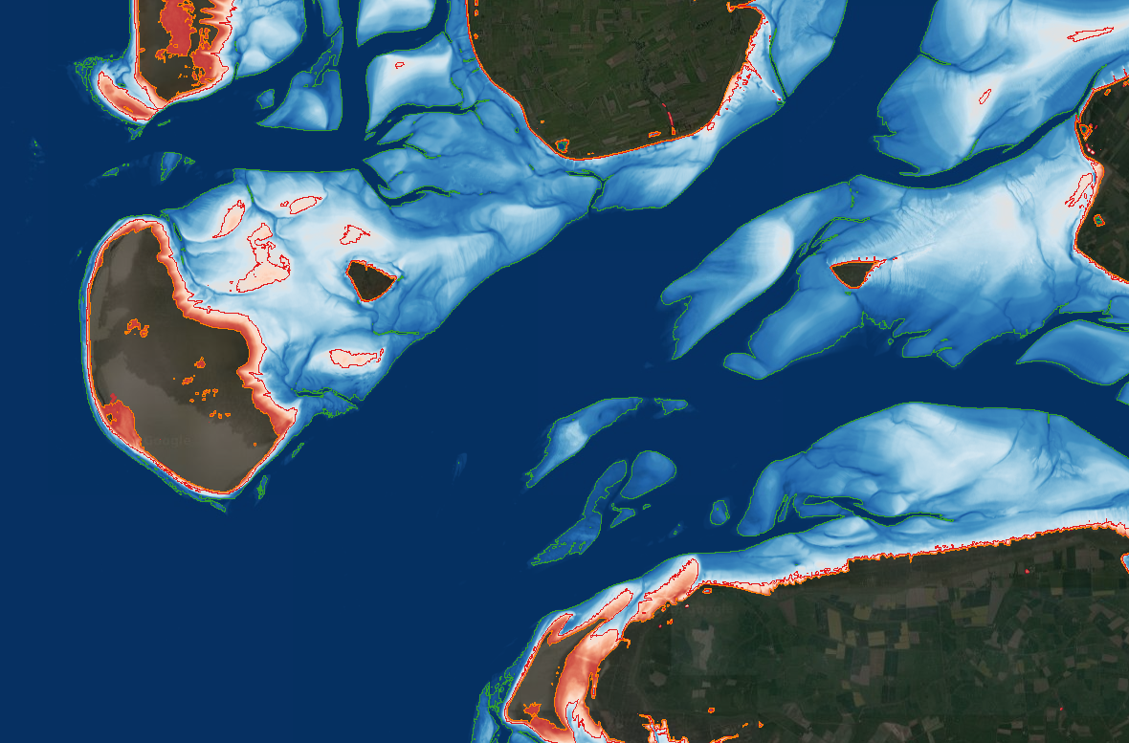
Water occurrence to coastline

Slide 19
Mean dynamic topography
Linking geoid to MSL

Slide 20
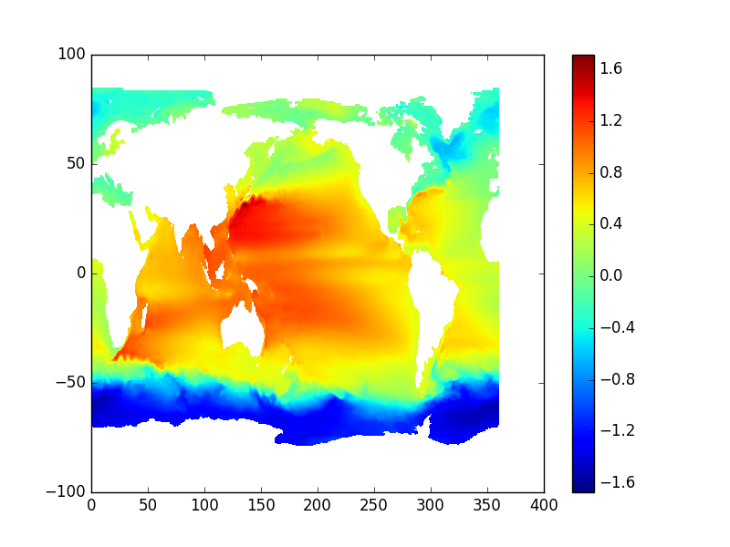
Mean Dynamic Topography
Satellite derived MDT
m
Source: aviso

Slide 21
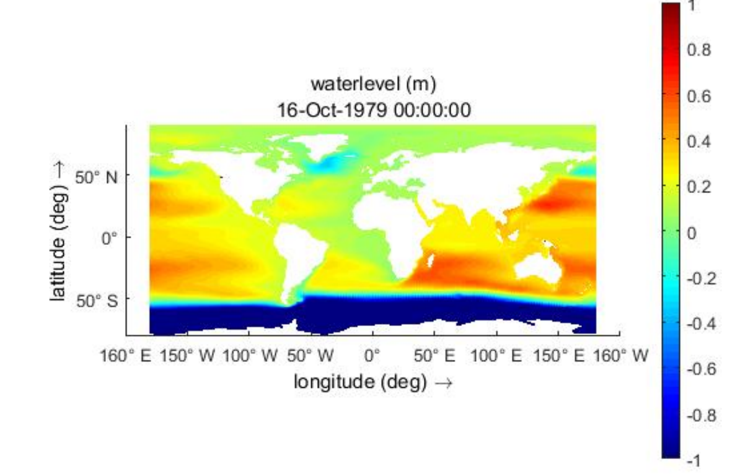
GTSM MDT test
Simplified one layer model

Slide 22
Questions?

